Slide 1
PHP Predefined Functions
ITWA113

Slide 2
PHP Predefined Functions
Objectives
• To know how to include separate PHP code in the main page for code enhancement.
• To be familiar with the use of common predefined function such as define, include, and require.
• To use different available mathematical function for manipulating numbers.
• To use number_format() function for number readability purpose.
• To apply different function for Array Manipulation using the function unset(), explode(), and implode().
• To manipulate string data using PHP string manipulation function.
• To manipulate date with format using date function and date format available.

Slide 3
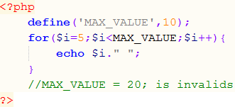

PHP Predefined Functions
Using Constant
define() functions
used to declare constants. A constant can only be assigned a scalar value, like a string or a number. A constant’s value cannot be changed.
Syntax:
define(‘NAME’,’value’);
Example:
Output:

Slide 4
PHP Predefined Functions
Including Files
You can separate your PHP file and embed it to your html by using PHP include functions.
Include functions | Description
include | Includes and evaluates the specified file. Generate a warning on failure message if file not found.
require | Performs the same way as the include function. Generate a fatal error message if file not found stopping the script at that point.
include_once | Same as include function except it includes the file only once.
require_once | Same as require function except it includes the file only once.
Syntax:
include(“file”);

Slide 5
PHP Predefined Functions
Including Files
Most of the developers used include functions for their header and footer. Also some use this to write their database connection and so on.
You may write the file with an extension name of .inc rather than .php to serve as a fragment of your program code.
In some scripts, a file might be included more than once, causing function redefinitions, variable reassignments, and other possible problems.
Syntax:
include(“filename.inc”);
include_once(“filename.inc”);
require(“filename.inc”);
require_once(“filename.inc”);

Slide 6
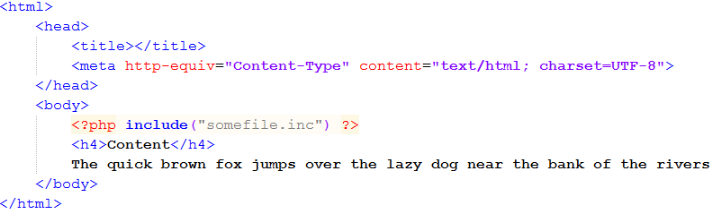
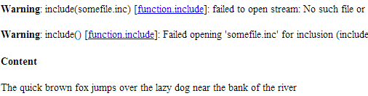
PHP Predefined Functions
Including Files: include()function (file not found)
Example:
Output:

Slide 7
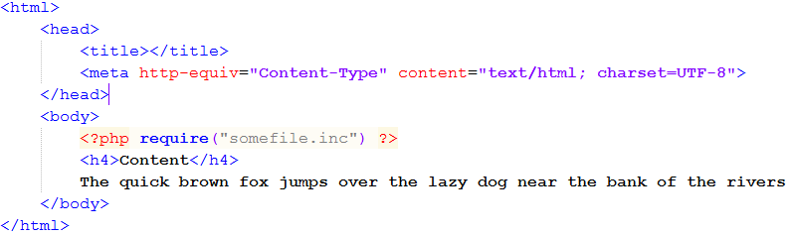

PHP Predefined Functions
Including Files: require() function (file not found)
Example:
Output:

Slide 8
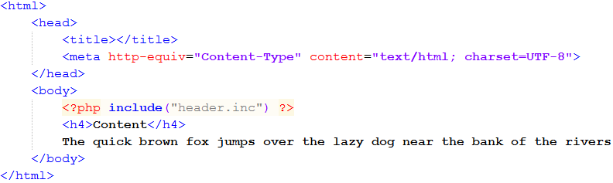
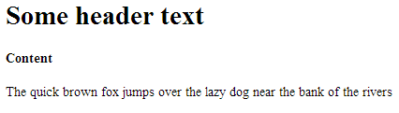
PHP Predefined Functions
Including Files: include()function (file exists)
Example:
header.inc
Output:
Same output using require function

Slide 9
PHP Predefined Functions
Mathematical Function:
rand() function
- used to generate random integers
- syntax
int rand(void)
int rand(int $min, int $max)
ceil() function
- returns the next highest integer by rounding the value upwards
- syntax
float ceil(float $value)
floor() function
- returns the next lowest integer by rounding the value downwards
- syntax
float floor(float $value)

Slide 10
PHP Predefined Functions
Mathematical Function:
min() function
- Return the smallest value
- syntax
mixed min(array $values)
mixed min(mixed $values1, mixed $values2[,mixed $...])
max() function
- Return the highest value
- syntax
mixed max(array $values)
mixed max(mixed $values1, mixed $values2[,mixed $...])

Slide 11
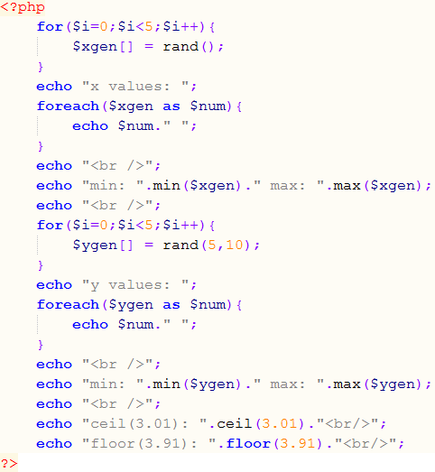
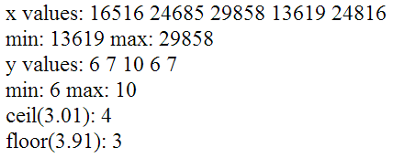
PHP Predefined Functions
Mathematical Function:
rand(), ceil(), floor(), min(), max()
Example:
Output:

Slide 12
PHP Predefined Functions
Mathematical Function:
number_format() function
- Format a number with grouped thousand
- syntax
string number_format (
float $number
[, int $decimals = 0 ] )
string number_format (
float $number ,
int $decimals = 0 ,
string $dec_point = '.' ,
string $thousands_sep = ',' )

Slide 13
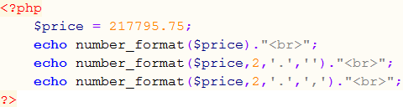

PHP Predefined Functions
Mathematical Function: number_format function
Example:
Output:

Slide 14
PHP Predefined Functions
Function for Array Manipulation:
unset function
- destroys the specified variable
- syntax:
void unset ( mixed $var [, mixed $... ] )
explode function
- split a string by string
- syntax:
array explode ( string $delimiter ,
string $string [, int $limit ] )
implode function
- join array elements to form a string
- syntax:
string implode ( string $glue , array $pieces )
string implode ( array $pieces )

Slide 15
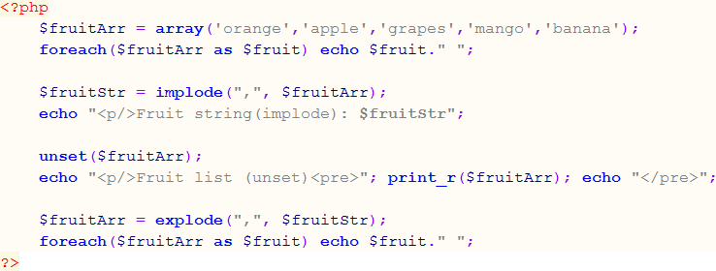
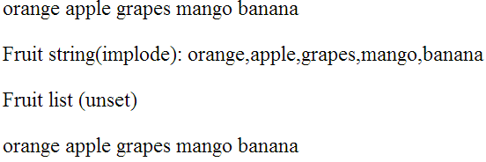
PHP Predefined Functions
Function for Array Manipulation:
unset(), explode(), implode()
Example:
Output:

Slide 16
PHP Predefined Functions
Function for String Manipulation:
strlen function
- return the value length of a string
- syntax:
int strlen (string $string)
strpos function
- find the position of the first occurrence of a substring in a given string
- syntax:
int strpos ( string $haystack ,
mixed $needle [, int $offset = 0 ] )
strrev function
- reverse a given string
- syntax:
string strrev ( string $string )

Slide 17
PHP Predefined Functions
Function for String Manipulation:
strtolower function
- converts string to lowercase
- syntax:
string strtolower ( string $str )
strtoupper function
- converts string to uppercase
- syntax:
string strtoupper ( string $str )
substr function
- returns part of a given string
- syntax: string substr ( string $string ,
int $start [, int $length ] )

Slide 18
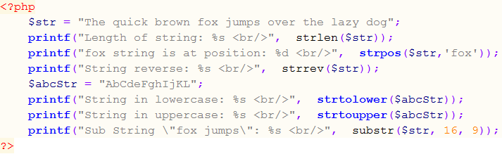
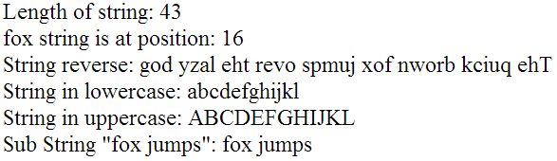
PHP Predefined Functions
Function for String Manipulation:
strlen(), strpos(), strrev(), strtolower(), strtoupper(), substr()
Example:
Output:

Slide 19
PHP Predefined Functions
Function for String Manipulation:
ucfirst() function
- Make a string’s first character uppercase
- syntax:
string ucfirst( string $str )
ucwords() function
- converts string to uppercase
- syntax:
string ucwords ( string $str )
trim() function
- stripped white spaces or other characters from the beginning and end of a string.
- syntax:
string trim ( string $str [, string $charlist ] )

Slide 20
PHP Predefined Functions
Function for String Manipulation:
ltrim() function
- strip white spaces or other characters from the beginning of a string.
- syntax:
string ltrim ( string $str [, string $charlist ] )
rtrim() function
- strip white spaces or other characters from the end of a string.
- syntax:
string rtrim ( string $str [, string $charlist ] )
strip_tags() function
- strip HTML and PHP tags from a string.
- syntax:
string strip_tags ( string $str [, string $allowable_tags ] )

Slide 21
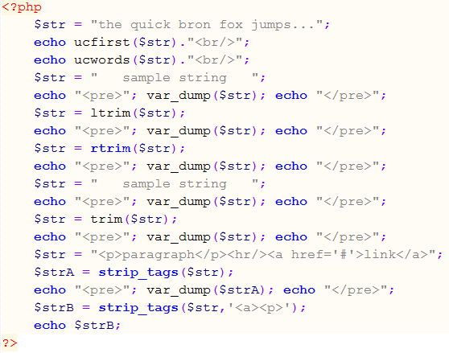
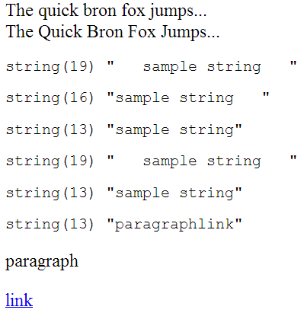
PHP Predefined Functions
Function for String Manipulation:
ucfirst(), ucwords(), trim(), ltrim(), rtrim(), strip_tags()
Output:
Example:

Slide 22
PHP Predefined Functions
Function for String Manipulation:
ucfirst(), ucwords(), trim(), ltrim(), rtrim(), strip_tags()
Output:
Example:

Slide 23
PHP Predefined Functions
Date Manipulation: date() Function
- used to format a local time or date
- returns a string formatted according to the given format string.
- syntax:
string date ( string $format [, int $timestamp = time() ] )
Format character | Description | Example returned values
DAY
d | Day of the month, 2 digits with leading zeros | 01 to 31
D | A textual representation of a day, three letters | Mon through Sun
j | Day of the month without leading zeros | 1 to 31
l | A full textual representation of the day of the week | Sunday through Saturday
N | ISO-8601 numeric representation of the day of the week (added in PHP 5.1.0) | 1 (for Monday) through 7 (for Sunday)

Slide 24
PHP Predefined Functions
Date Manipulation: date() Function
Format character | Description | Example returned values
S | English ordinal suffix for the day of the month, 2 characters | st, nd, rd or th. Works well with j
w | Numeric representation of the day of the week | 0 (for Sunday) through 6 (for Saturday)
z | The day of the year (starting from 0) | 0 through 365
WEEK
W | ISO-8601 week number of year, weeks starting on Monday | Example: 42 (the 42nd week in the year)

Slide 25
PHP Predefined Functions
Date Manipulation: date() Function
Format character | Description | Example returned values
MONTH
F | A full textual representation of a month, such as January or March | January through December
m | Numeric representation of a month, with leading zeros | 01 through 12
M | A short textual representation of a month, three letters | Jan through Dec
n | Numeric representation of a month, without leading zeros | 1 through 12
t | Number of days in the given month | 28 through 31

Slide 26
PHP Predefined Functions
Date Manipulation: date() Function
Format character | Description | Example returned values
YEAR
L | Whether it's a leap year | 1 if it is a leap year, 0 otherwise.
o | ISO-8601 year number. This has the same value as Y, except that if the ISO week number (W) belongs to the previous or next year, that year is used instead. | Examples: 1999 or 2003
Y | A full numeric representation of a year, 4 digits | Examples: 1999 or 2003
y | A two digit representation of a year | Examples: 99 or 03

Slide 27
PHP Predefined Functions
Date Manipulation: date() Function
Format character | Description | Example returned values
TIME
a | Lowercase Ante meridiem and Post meridiem | am or pm
A | Uppercase Ante meridiem and Post meridiem | AM or PM
B | Swatch Internet time | 000 through 999
g | 12-hour format of an hour without leading zeros | 1 through 12
G | 24-hour format of an hour without leading zeros | 0 through 23
h | 12-hour format of an hour with leading zeros | 01 through 12
H | 24-hour format of an hour with leading zeros | 00 through 23
i | Minutes with leading zeros | 00 to 59
s | Seconds, with leading zeros | 00 through 59
u | Microseconds | Example: 654321

Slide 28
PHP Predefined Functions
Date Manipulation: date() Function
Format character | Description | Example returned values
TIMEZONE
e | Timezone identifier | Examples: UTC, GMT, Atlantic/Azores
I | Whether or not the date is in daylight saving time | 1 if Daylight Saving Time, 0 otherwise.
O | Difference to Greenwich time (GMT) in hours | Example: +0200
P | Difference to Greenwich time (GMT) with colon between hours and minutes | Example: +02:00
T | Timezone abbreviation | Examples: EST, MDT ...
Z | Timezone offset in seconds. The offset for timezones west of UTC is always negative, and for those east of UTC is always positive. | -43200 through 50400

Slide 29
PHP Predefined Functions
Date Manipulation: date() Function
Format character | Description | Example returned values
FULL DATE/TIME
c | ISO 8601 date | 2004-02-12T15:19:21+00:00
r | » RFC 2822 formatted date | Example: Thu, 21 Dec 2000 16:01:07 +0200
U | Seconds since the Unix Epoch (January 1 1970 00:00:00 GMT) | See also time()
http://php.net/docs.php

Slide 30
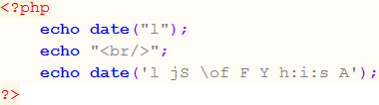

PHP Predefined Functions
Date Manipulation: date() Function
Example:
Output:

Slide 31
PHP Predefined Functions
Date Manipulation: mktime() function
- get the unix timestamp (January 1, 1970) for a given date. (with strict notice)
- same as time() function (without strict notice)
- syntax:
int mktime ([ int $hour = date("H")
[, int $minute = date("i")
[, int $second = date("s")
[, int $month = date("n")
[, int $day = date("j")
[, int $year = date("Y")
[, int $is_dst = -1 ]]]]]]] )

Slide 32
PHP Predefined Functions
Date Manipulation: strtotime() function
- parse any English textual datetime description into a Unix timestamp
- syntax:
int strtotime ( string $time
[, int $now = time() ] )

